Slide 1

Smart Government Scheme Finder
Theme- SDG Goals :SDG 10:Reduced Inequalities
SDG 16: Peace, Justice & Strong Institutions
Category- Software
Group No -7
Group Members-Janhavi More, Sayali Deve, Isha Sonawane, Shreelesh Pawar
Guide- Prof. Snehal Kangane

Slide 2
Outline
Introduction
Literature Survey
Limitations
Problem statement and Objectives
Proposed Methodology
Experimental Setup
Implementation
Results & Analysis
Conclusion and Future work
References

Slide 3
Introduction
Background
- Government provides various welfare schemes for citizens
- Information is distributed across multiple portals
- Many users are unaware of eligibility criteria
Importance
- Deserving people often miss scheme benefits
- Eligibility rules are complex to understand
- Lack of a personalized recommendation system

Slide 4
Introduction
Motivation
- To improve awareness about schemes
- To promote financial inclusion among citizens
- To support SDG 10 and SDG 16 goals
Objectives
- Build an eligibility-based smart system
- Provide personalized scheme suggestions
- Explain “Why am I eligible?” clearly
- Simplify the process of finding schemes

Slide 5
Literature Survey
Existing Solutions
- National and state government portals
- MyScheme portal
- Apps with category-based filtering
- Basic FAQ chatbot systems
Methodologies Used Existing System
- Manual searching by users
- Keyword-based filtering
- Static display of scheme data
Limitations Identified
- Lack of intelligent eligibility matching
- No personalized recommendations
- Complex navigation and poor user experience

Slide 6
Limitations of existing Systems
Manual filtering is required by users
Process is time-consuming and inefficient
No personalized dashboard or tracking system
No proper explanation for eligibility
Lack of intelligent and automated filtering

Slide 7
Problem statement and Objectives
Problem Statement
To design a smart web-based system that recommends government schemes based on user eligibility and also explains the reason behind selection in a clear manner.
Objectives
- Collect user demographic details accurately
- Apply rule-based eligibility logic efficiently
- Display only relevant and eligible schemes
- Provide chatbot-based guidance
- Ensure transparency in filtering process

Slide 8
Proposed Methodology
System Modules
- User Module for data input and interaction
- Admin Module for managing scheme data
- Eligibility Engine for applying rules
- Recommendation System for filtering schemes
- Rule-based Chatbot for assistance
Innovation & Value Addition
- Eligibility-based smart recommendations
- “Why Am I Eligible?” explanation feature
- Assisted mode for non-technical users
- Transparent and understandable filtering logic
- Chatbot support for real-time guidance

Slide 9
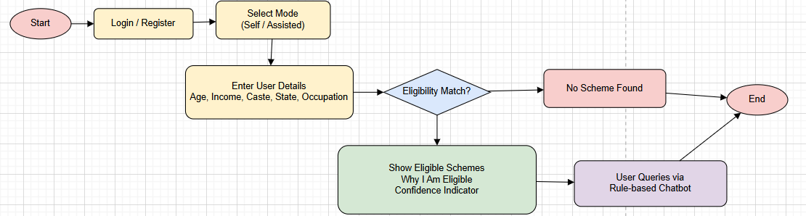
Proposed Methodology
Workflow

Slide 10
Experimental Setup
Dataset
- Structured scheme dataset (name, benefits, category, rules)
- User profile dataset (age, income, state, caste, occupation)
Technologies Used
- Frontend: HTML, CSS , JavaScript
- Backend: PHP
- Database: MySQL
- Server: XAMPP
Performance Parameters
- Accuracy of scheme recommendations
- Response time for generating results
- User satisfaction and ease of use
- System usability and efficiency

Slide 11
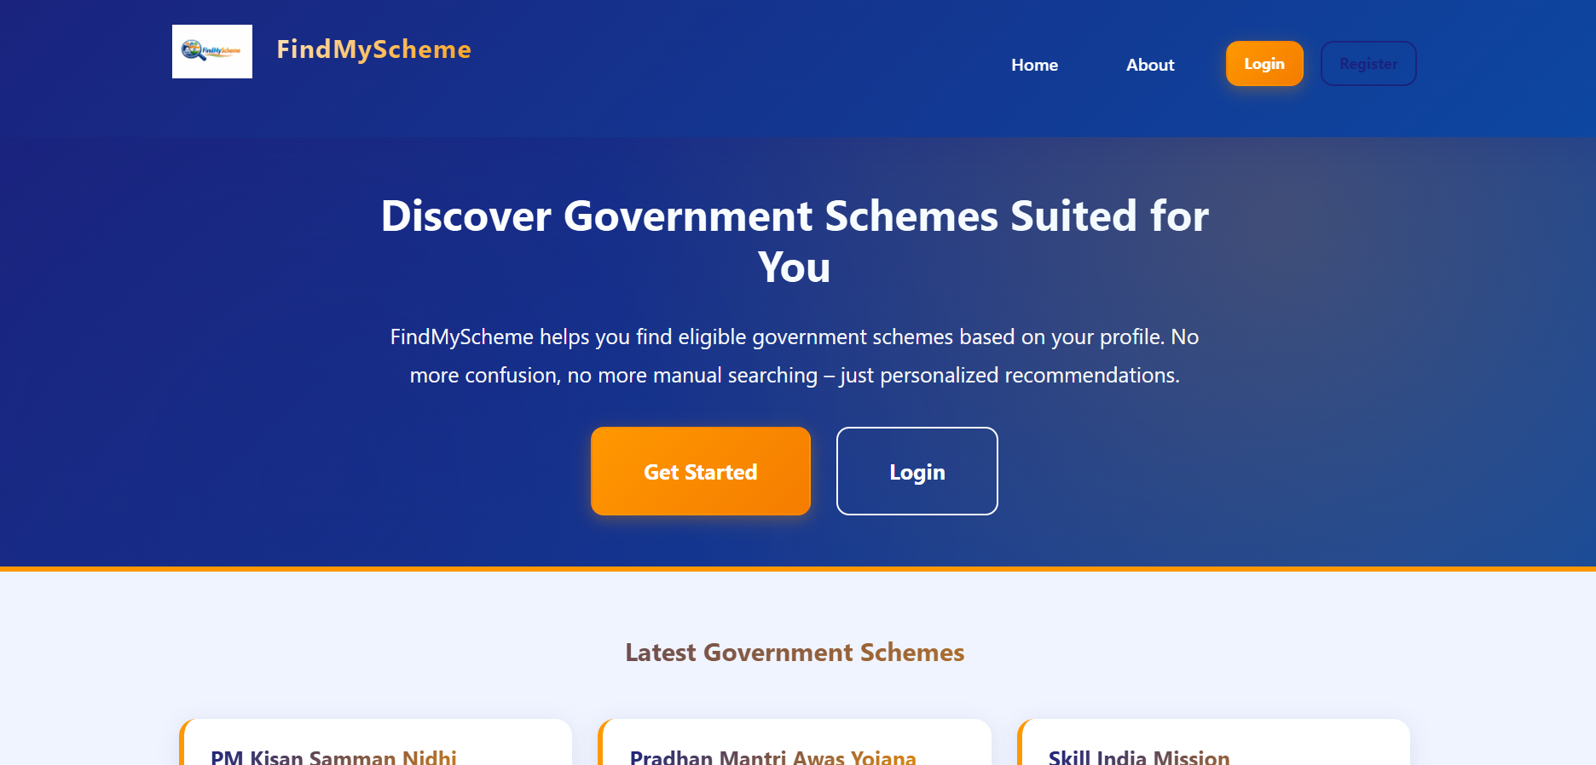
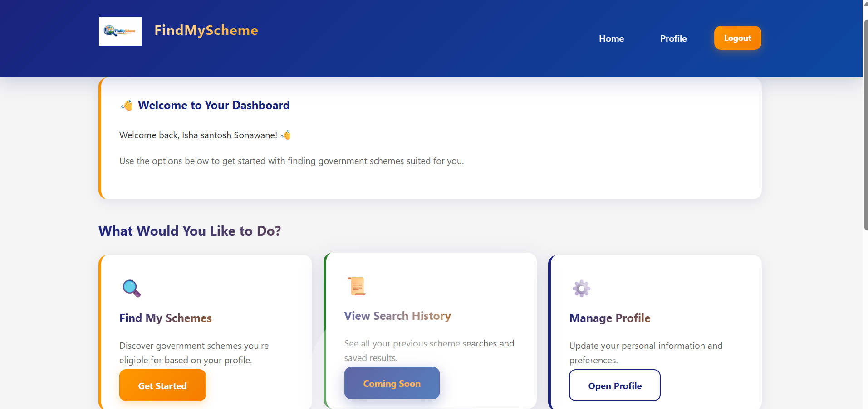
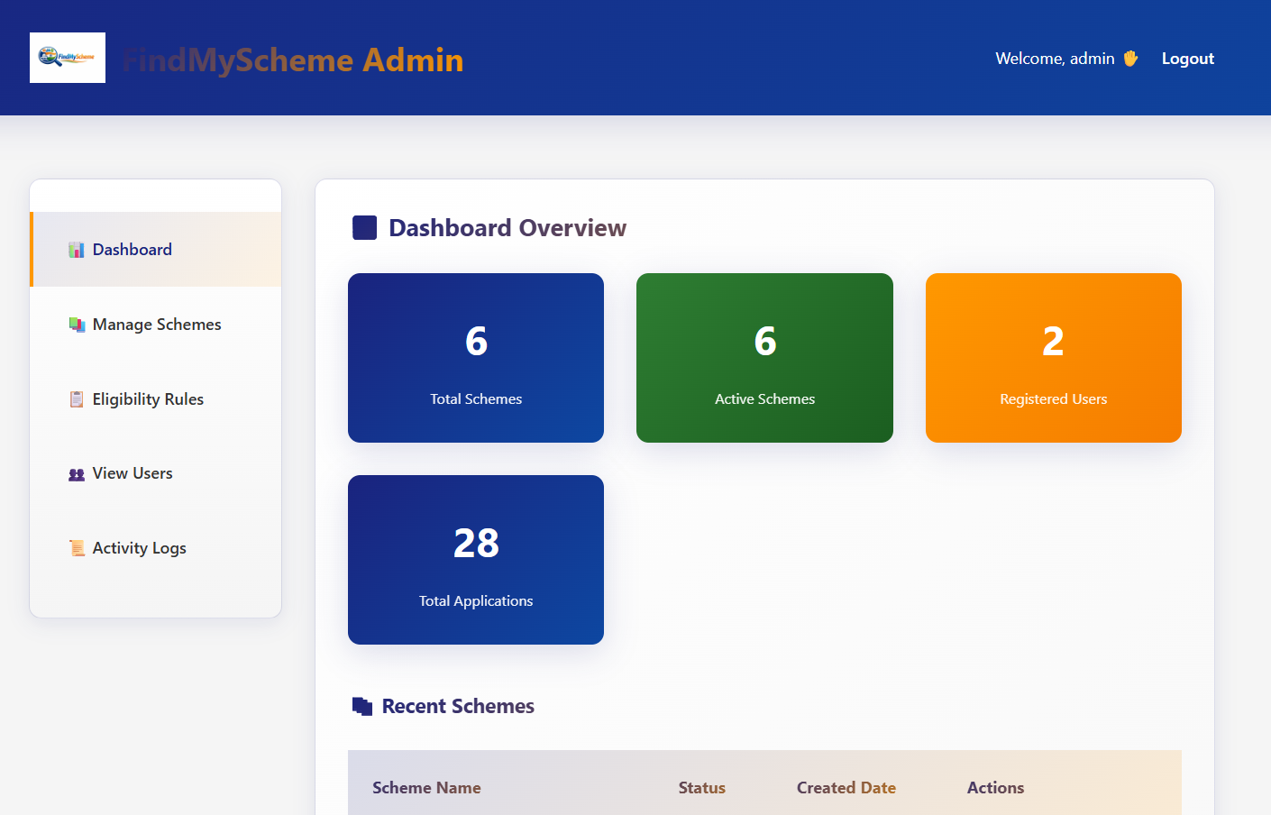
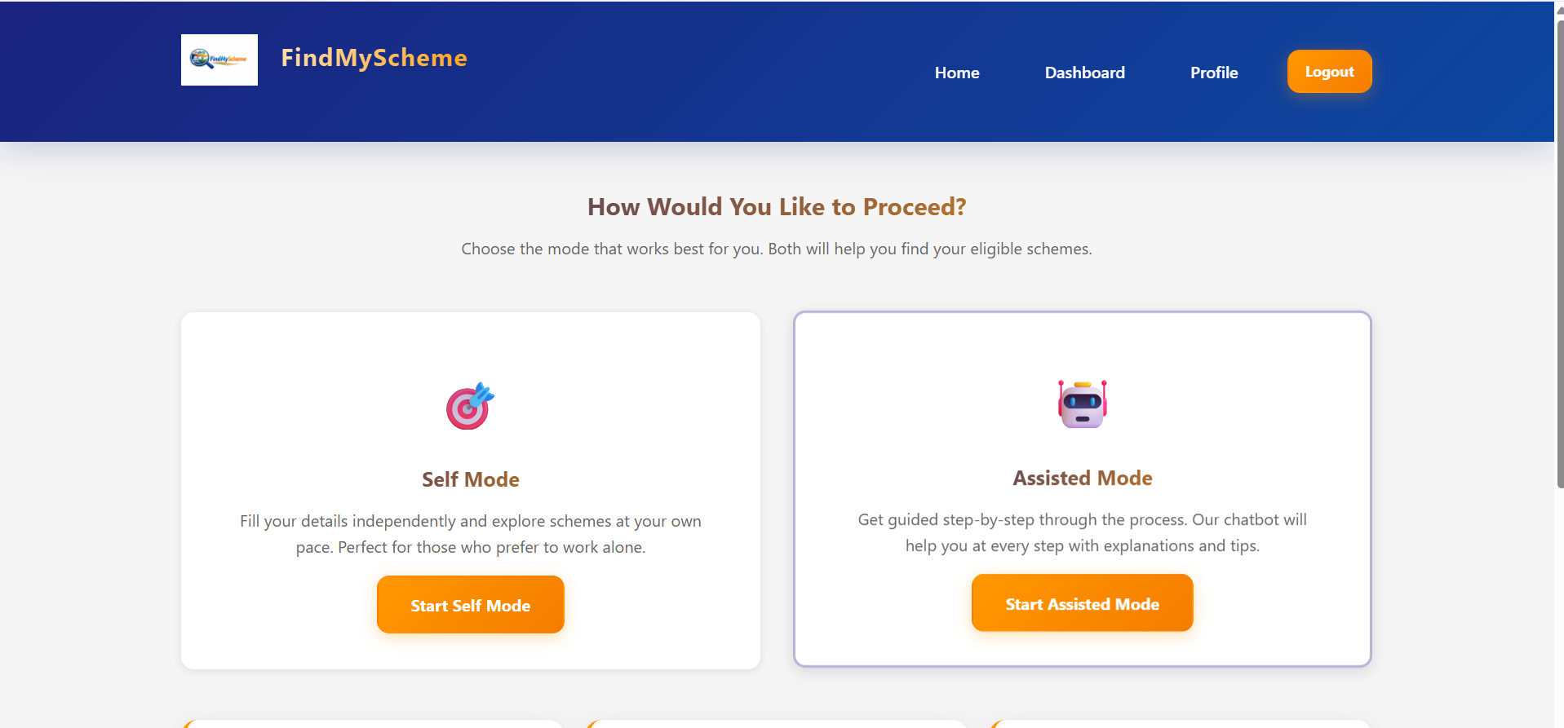
Implementation
Home page - User Dashboard
Admin Dashboard - Mode Selection

Slide 12
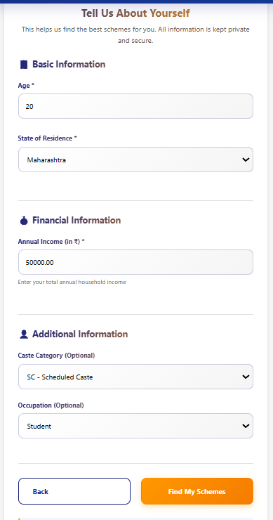
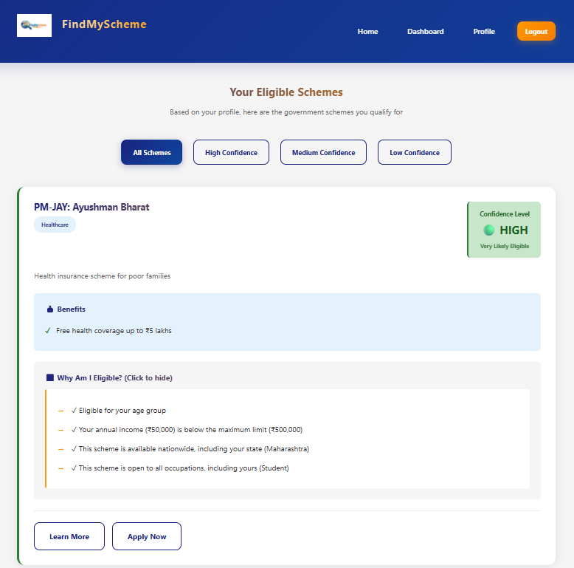
Implementation
Information Form - Result Page
Admin Dashboard - Mode Selection

Slide 13
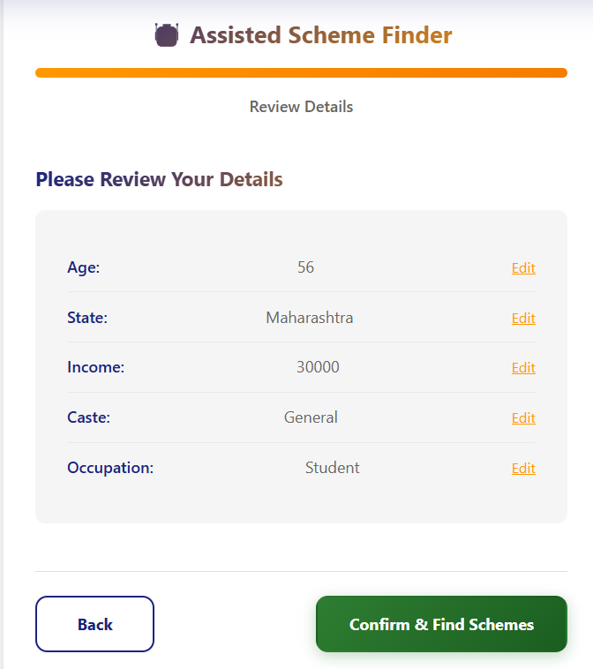
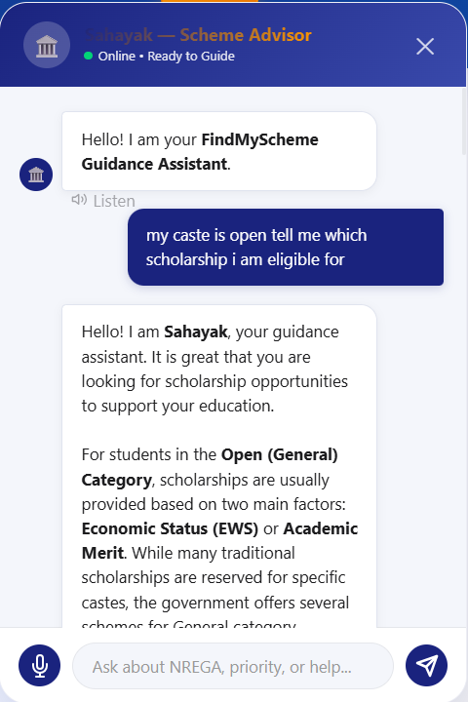
Implementation
Chatboat - Assisted mode

Slide 14
Results & Analysis
Performance Metrics
-Achieved around 100% accuracy in recommendations
- Faster performance compared to manual portals
- Reduced dependency on agents and middlemen
- Improved user experience and satisfaction
Comparison
Feature | Existing System | Proposed System
Manual Search | Yes | No
Smart Matching | No | Yes
Eligibility Explanation | No | Yes
Chatbot Support | Limited | Yes

Slide 15
Conclusion and Future work
Conclusion
- Successfully developed a smart scheme finder system
- Increased awareness and accessibility of schemes
- Provided transparent eligibility explanations
- Effectively supports SDG-based goals
Future Work
- Integration of AI-based recommendation system
- Multi-language support for wider accessibility
- Development of mobile application version
- Real-time integration with government APIs

Slide 16
References
[1] Government of India, “myScheme Portal – Government Scheme Discovery Platform,” 2024. [Online]. Available: https://www.myscheme.gov.in
[2] Government of India, “National Portal of India,” 2024. [Online]. Available: https://www.india.gov.in
[3] Google AI, “Gemini API Documentation,” Google Developers, 2024. [Online]. Available: https://ai.google.dev
[4] Oracle Corporation, MySQL 8.0 Reference Manual, Oracle, 2023. [Online]. Available: https://dev.mysql.com/doc
[5] PHP Group, PHP Manual, 2023. [Online]. Available: https://www.php.net/docs.php
[6] Apache Friends, XAMPP Documentation, Apache Friends, 2023. [Online]. Available: https://www.apachefriends.org
[7] I. Sommerville, Software Engineering, 10th ed. Boston, MA, USA: Pearson, 2016.
[8] R. S. Pressman and B. R. Maxim, Software Engineering: A Practitioner’s Approach, 8th ed. New York, NY, USA: McGraw-Hill, 2015.
[9] J. Han, M. Kamber, and J. Pei, Data Mining: Concepts and Techniques, 3rd ed. San Francisco, CA, USA: Morgan Kaufmann, 2012.
[10] S. Russell and P. Norvig, Artificial Intelligence: A Modern Approach, 3rd ed. Upper Saddle River, NJ, USA: Pearson, 2010.
[11] A. Heeks, “Information Systems and Developing Countries: Failure, Success and Local Improvisations,” The Information Society, vol. 18, no. 2, pp. 101-112, 2002.

Slide 17
Thank You...!!

